Slide 1
McNulty and Associates
Principal Predictors of Heart Disease

Slide 2
The Data
Data from four hospital databases was combined to form the complete data set for this analysis. The data comprises 899 records and 76 fields, some of which are missing data.

Slide 3
Feature Selection
Began with over 75 features
Removed features with more than 100 null values
Performed recursive feature selection on remaining features
Used a Logistic Regression Model
Final feature count reduced to 14

Slide 4
Models Explored
Using the 14 final features, several models were built to evaluate which is optimal
Logistic Regression
kNN
SVC (RBF Kernel)
SVC (Linear Kernel)
Gaussian Naive Bayes
Multinomial Naive Bayes
Decision Tree
Random Forest

Slide 5
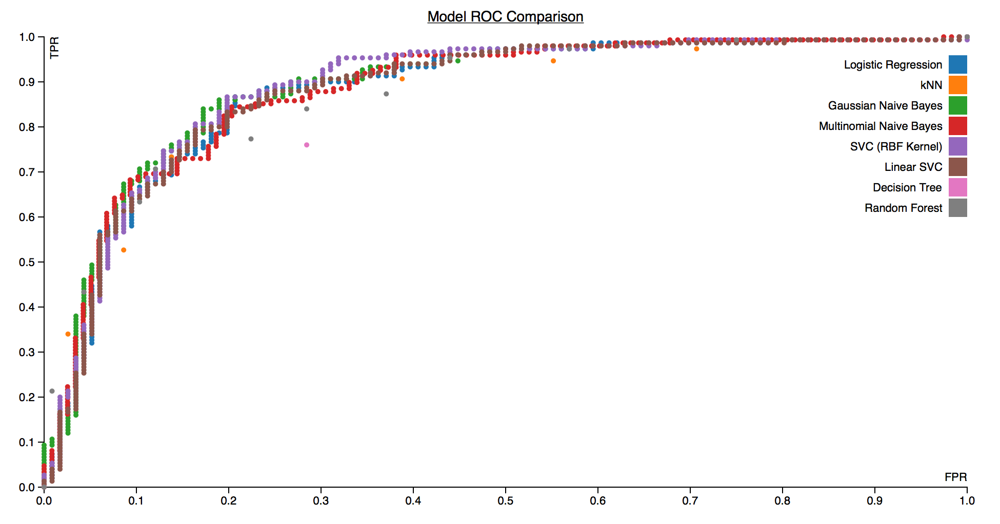
Models Evaluated

Slide 6
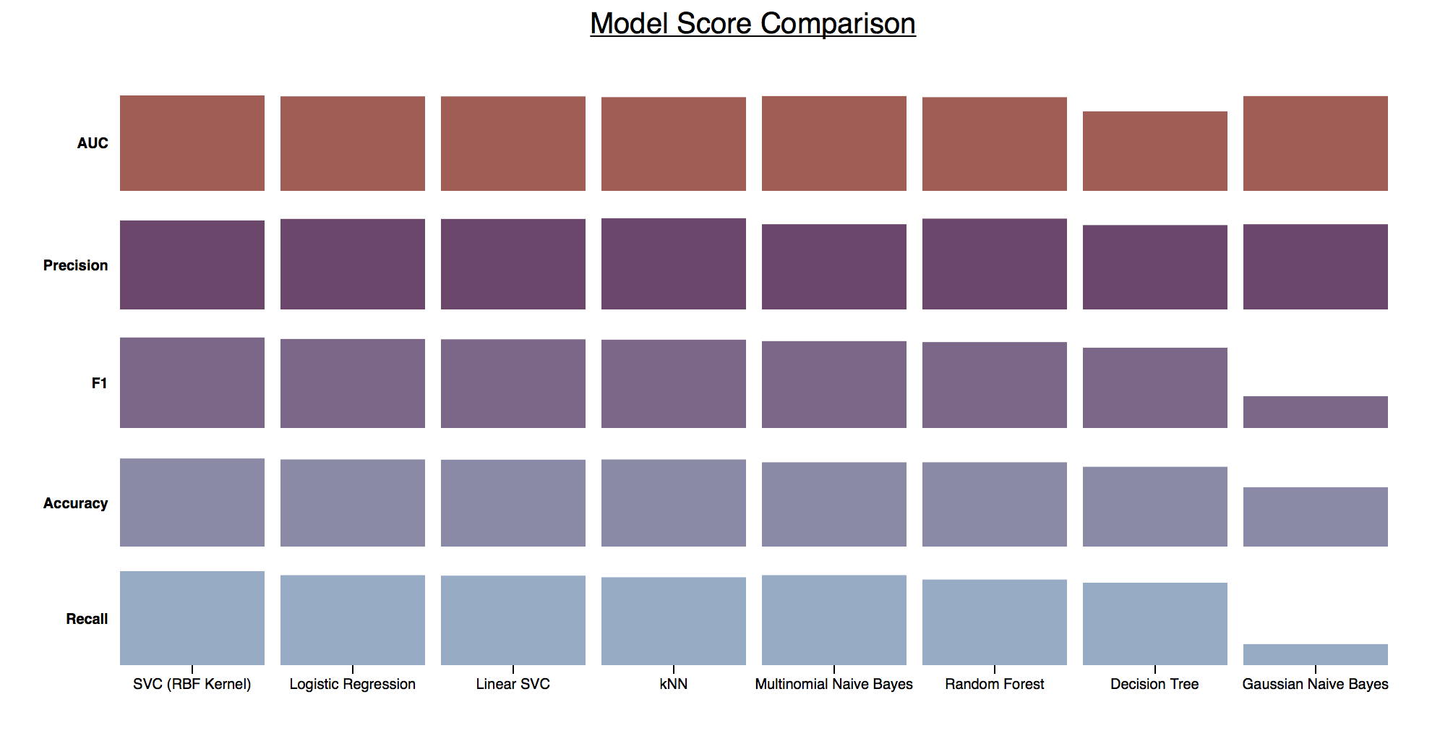
Models Evaluated

Slide 7
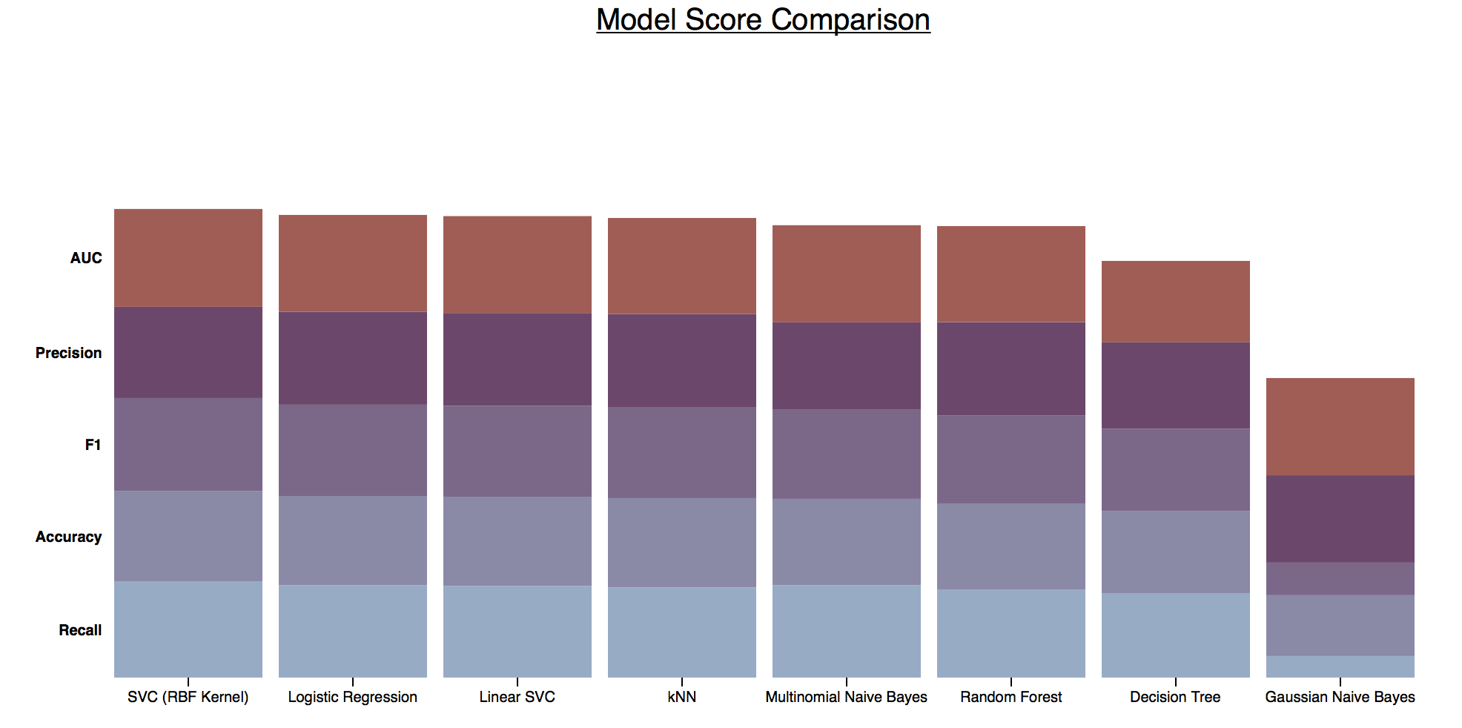
Models Evaluated

Slide 8
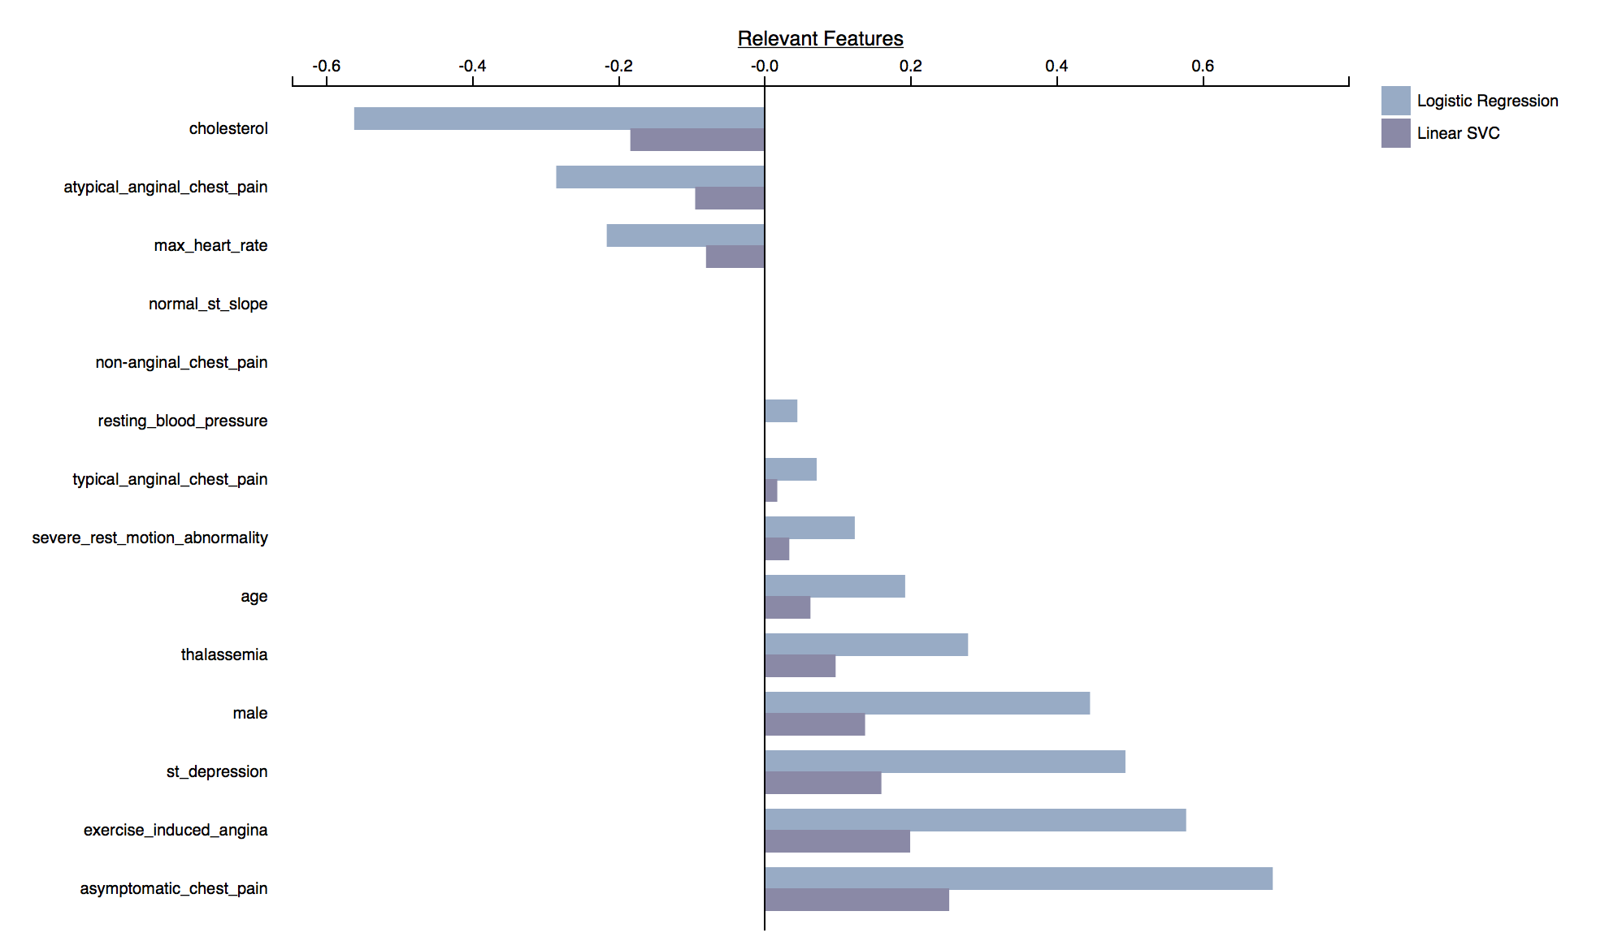
Feature Importance

Slide 9
Takeaways
It is possible to determine, with reasonable accuracy, whether or not someone has heart disease
This can be done with only 14 features results, most of which are readily available or easy to obtain

